Slide 1
Admiral IT Fantasy League
Week X Tuesday Morning QB

Slide 2
Scores
Team 1 | Score | Record | Team 2 | Score | Record

Slide 3
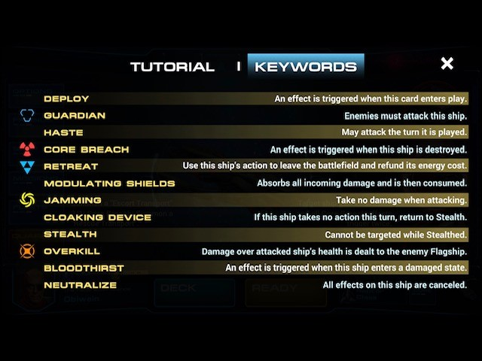
Standings
One
Two
Three
Four
Five
Six
Seven
Eight
Nine
Ten

Slide 4
Tale of the Tape
Team 1 vs Team 2

Slide 5
Tale of the Tape
Team 1 vs Team 2

Slide 6
Tale of the Tape
Team 1 vs Team 2

Slide 7
Tale of the Tape
Team 1 vs Team 2

Slide 8
Tale of the Tape
Team 1 vs Team 2

Slide 9
Trade Summaries

Slide 10
Picks that Paid Off

